Slide 1
REVIEW : PROJECT WORK-1
BE VII SEM

Slide 2
CAREER GUIDANCE SYSTEM USING ML TECHNIQUES
Names :
Yousuf Ali (1604-19-737-106)
Osman Ali (1604-19-737-109)
Syed Rafey Ahmed (1604-19-737-113)
Under the Guidance : Mr. Md. Asrar Ahmed
Designation : MJCET

Slide 3
OUTLINE FOR PRESENTATION
Introduction
Literature Survey
Disadvantages of Existing System
Problem Statement
Proposed System
Project Plan
References

Slide 4
Introduction
While graduation signifies the end of college many students can be left wondering, 'what's next?' Many students face a difficult time choosing a career path in college, especially in fields like Engineering where there are vast domains to choose from.
Thus it is very important for students to assess their capabilities and identify their interests while pursuing their studies so that they are clear about their dreams and the career path leading towards it.
Thus, we have proposed an idea of an ML-based “Career Guidance System” which helps the students (esp. In their pre-final and final year) to decide the job role the candidate should undertake based on his/her performance and other evaluations.
Not only that recruiters while recruiting people into their companies evaluate candidates on different parameters and draw a final conclusion to select an employee or not and if selected, finds a best suited role and career area for him.

Slide 5
UNIQUENESS OF OUR PROPOSED SYSTEM
Already these type of various career recommendation systems
and job role recommendation, prediction systems are being
used in various third party performance evaluation portals like
Co-Cubes, AMCAT. They only take factors like technical abilities
and psychometry of students into consideration.
These portals asses the students technically and suggest the students and companies job roles suited on their performance.
But here various factors including abilities of students in sports, academics and their hobbies, interests, competitions, skills and knowledge are also taken into consideration.

Slide 6
Literature Survey
Author | Method | Accuracy
K. B. Eashwar [1] | Predicting Student Performance using combined SVM and K-means method | 89 %
Min Nie et [2] | proposed a novel model known as ACCBOX (Approach Cluster Centers Based On XGBOOST) to forecast student’s choices in their career | 92%
Ankita Kadambande [3] | uses semantic rules and SVM concepts to do predictions | 85%
S.A. Oloruntoba [4] | student’s performance is predicted by using SVM concept. The result of this classifier is compared with other machine learning concepts like linear regression, KNN and decision tree | 90%

Slide 7
Disadvantages of Existing System
Sometimes Counselors have limited Knowledge to tackle the situation or give a solution to a problem.
The outcome can be influenced by the counsellor’s personal interests.
There might be uncertainties. It is not sure or guaranteed for the desired outcome.
It is difficult to find qualified and trustworthy career counselors and some people cannot afford costs for counselling.

Slide 8
Disadvantages of Existing System
There are various websites and web apps over the internet which helps students to know their suitable career path. But most of those systems only used personality traits as the only factor to predict the career, which might result in an inconsistent answer.
Similarly, there are few sites that suggest career based on only the interests of the students. The systems did not use the capacity of the students to know whether they would be able to survive in that field or not.

Slide 9
To develop an effective Career recommendation system
Which takes students’ abilities in academics, technicality, hobbies, interests, psychometry, skills, and knowledge into consideration and suggest suitable job roles.
Problem Statement

Slide 10
Proposed System
DATA PROCESSING
For student career prediction many parameters are required like students academic scores in various subjects, specializations, programming and analytical capabilities, memory, personal details like relationship, interests, sports, competitions, hackathons, workshops, certifications, books interested and many more.
As all these factors play vital role in deciding stu_x0002_dent’s progress towards a career area, all these are taken in_x0002_to consideration.
some amount of data is collected through LinkedIn api, some amount of data is randomly generated and other from college alumni database

Slide 11
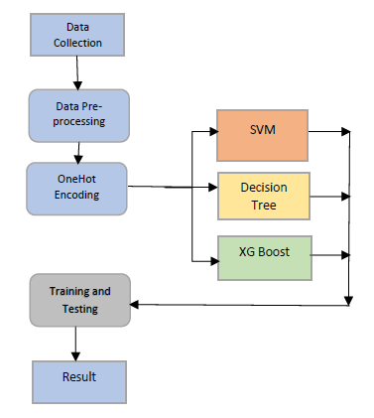
Proposed System
DATA PRE-PROCESSING
Data collected from various means will be in an unorganized format and there may be lot of null values, invalid data values and unwanted data.
Cleaning all these data and replacing them with appropriate or approximate data and removing null and missing data and replacing them with some fixed alternate values are the basic steps in pre processing of data
Data must be kept in a organized format.
Figure : Process Flow Diagram of proposed system

Slide 12
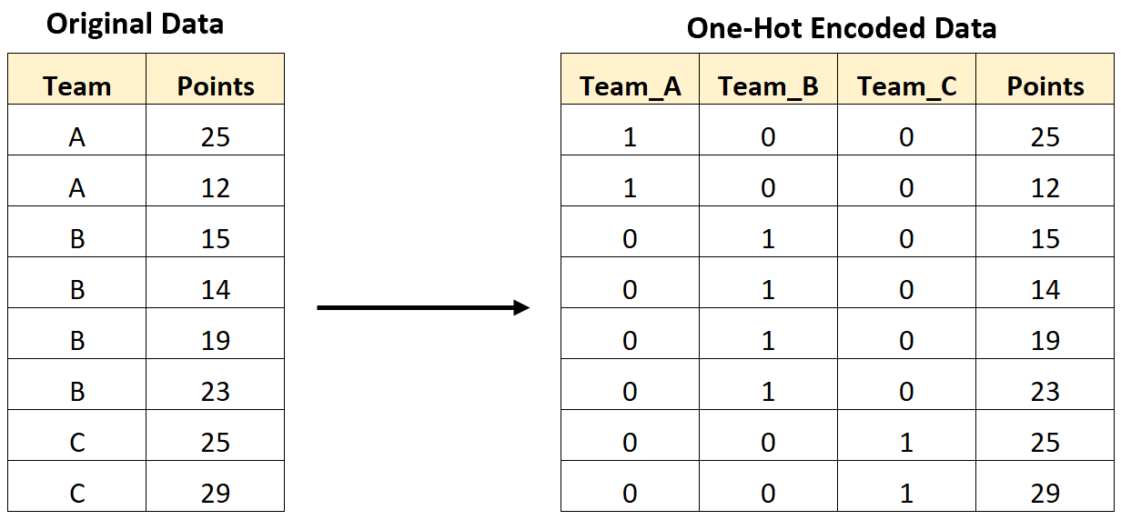
Proposed System
ONE HOTENCODING
OneHot Encoding is a technique by which categorial values present in the data collected are converted into numerical or
other ordinal format so that they can be
provided to machine learning algorithms
and get better results of prediction.
OneHot encoding transforms categorial values into a form that best fits as input to feed to various machine learning algorithms
This algorithm works fine with almost all modern day machine learning algorithms.

Slide 13
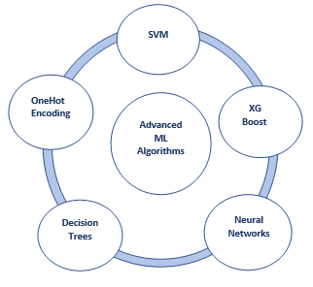
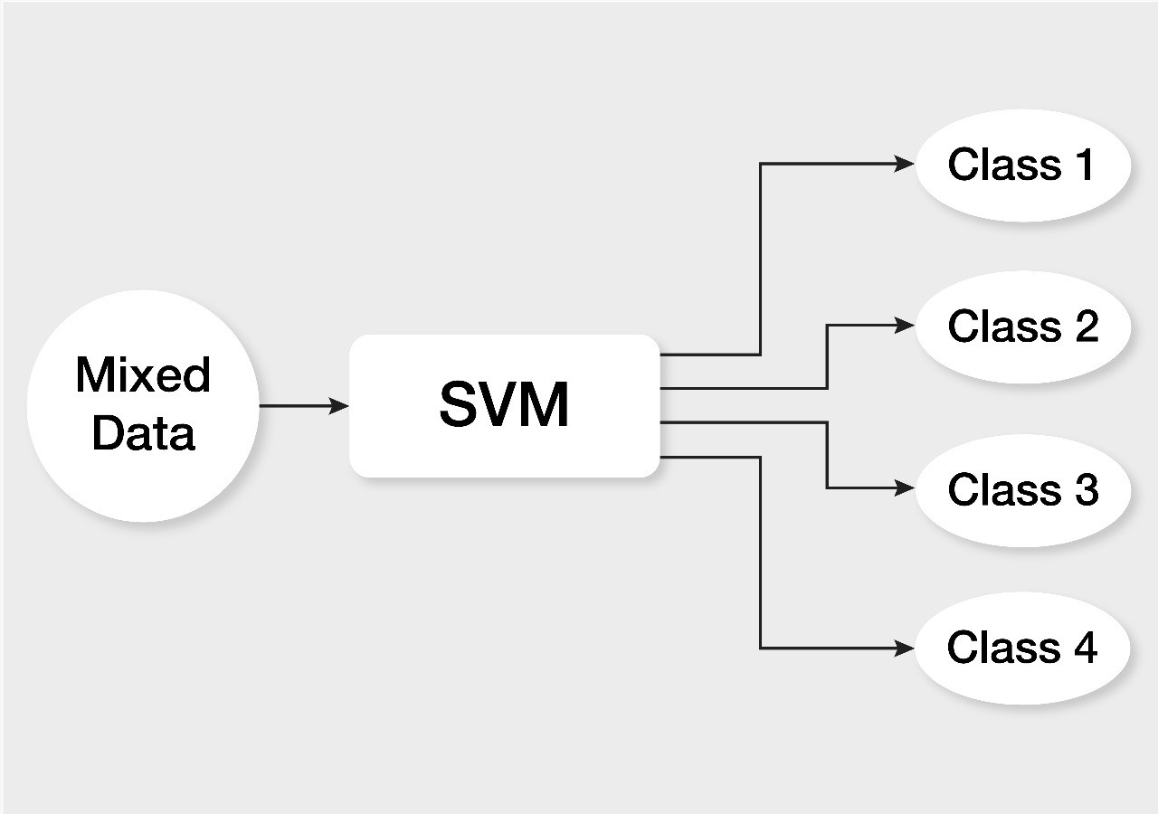
Proposed System
Machine Learning Algorithms
SVM:
SVM or Support Vector Machine is a linear model for classification and regression problems.
It can solve linear and non-linear problems and work well for many practical problems.
The idea of SVM is simple: The algorithm creates a line or a hyperplane which separates the data into classes.
Figure : Overview of various Advanced Machine
Learning Algorithms

Slide 14
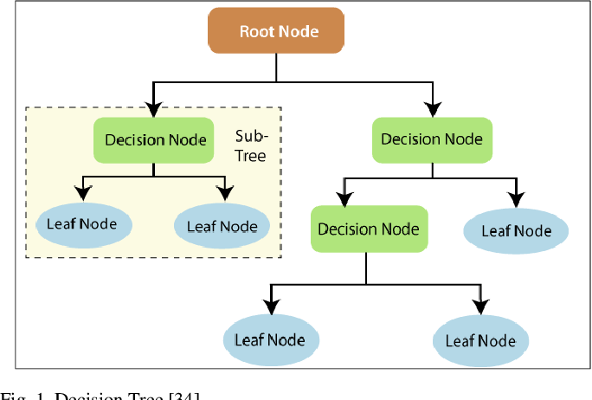
Proposed System
Machine Learning Algorithms
2. Decision Tree:
Decision Trees are extremely popular and one of the simple and easy to implement machine
learning classification problems
The typical scenario that a decision tree follows is first selecting a root node. Calculate information gain or entropy for each of the nodes before the split.
Select the node that has more information gain or less entropy. Further split the node and reiterate
the process
Figure : Structure of a Decision tree algorithm

Slide 15
System Requirements
HARDWARE
Windows 7,8,9,10
RAM 4GB
SOFTWARE
Ananconda Navigator
Python Language
Jupyter notebook

Slide 16
Project plan
Activity | Plan Start (Weeks) | Plan Duration (Weeks) | Actual Start (Weeks) | Actual Duration (Weeks) | Progress (%)
Problem Definition | 1 | 2 | 1 | 1 | 100%
Abstract | 3 | 1 | 4 | 1 | 100%
Literature Survey | 3 | 8 | 7 | 3 | 100%
System Analysis | 9 | 5 | 8 | 3 | 100%
Review I | 16 | 1 | 10 | 1 | 99.9%
System Design | 17 | 2
Implementation | 19 | 10
Testing | 30 | 2
Documentation | 3 | 32
Review II | 32 | 1

Slide 17
References
[1] Ali Daud, Naif Radi Aljohani, “Predicting Student Performance using Advanced Learning Analytics”, 2019 International World Wide Web Conference Committee (IW3C2).
[2] Marium-E-Jannat, Sayma Sultana, Munira Akther, “A Probabilistic Machine Learning Approach for Eligible Candidate Selection”, Inter-national Journal of Computer Applications (0975 – 8887)Volume 144 – No.10, June 2018.
[3] Rutvija Pandya Jayati Pandya , “C5.0 Algorithm to Improved Decision Tree with Feature Selection and Reduced Error Pruning“, Inter-national Journal of Computer Applications (0975 – 8887) Volume 117 – No. 16, May 2017.
[4] Anuj Karpatne, Gowtham Atluri, “Theory- Guided Data Science: A New Paradigm for Scientific Discovery from Data”, IEEE trans-actions on knowledge and data engineering, vol.29, no. 10, october 2018.

Slide 18
References (1)..
[5] Min Nie , ZhaohuiXiong , RuiyangZhong , Wei Deng and Guowu Yang (2020), “ Career Choice Prediction Based on Campus Big Data—Mining the Potential Behavior of College Students” , Journal of Appl. Sci. pp. 1-14.
[6] K. B. Eashwar, R. Venkatesan and D. Ganesh (2017), “Student Performance Prediction Using SVM”, International Journal of Mechanical Engineering and Technology (IJMET) Vol. 8, No. 11, pp. 649–662.
[7] AnkitaKadambande, Snehal Thakur, AkshataMoholand A.M.Ingole (2019), “Predict Student Performance by Utilizing Data Mining Technique and Support Vector Machine”, International Research Journal of Engineering and Technology (IRJET), Vol. 04, No. 05, pp 2818-2821.
[8] S.A. Oloruntoba1 and J.L.Akinode (2018), “Student Academic Performance Prediction Using Support Vector Machine”, International Journal Of Engineering Sciences & Research Technology, pp. 588-598.

Slide 19
Thank you !

